Slide 1

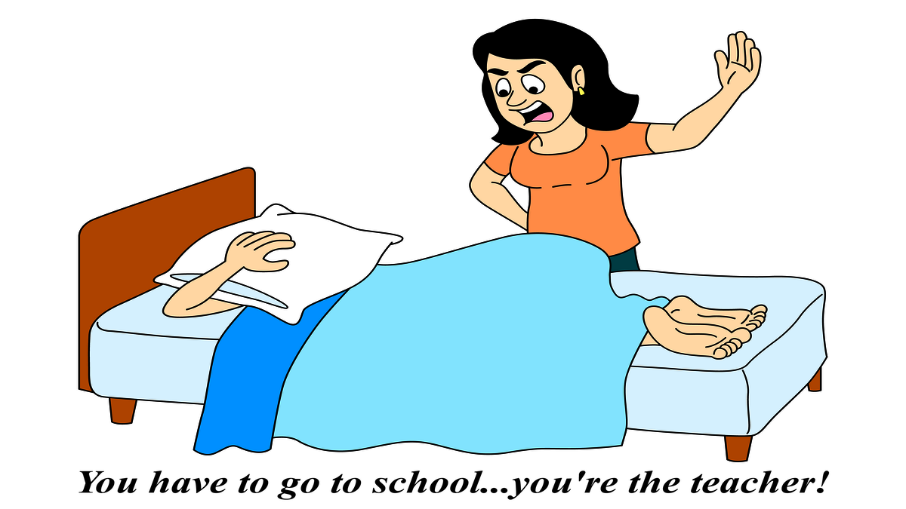
Personal Effectiveness & Wellbeing

Slide 2
This Training
Understand what has the biggest impact on your personal energy and wellbeing
Build the knowledge and skills to be fully engaged and perform at your best, regardless of conditions

Slide 3
2018 Union Survey
74% reported low energy levels
84% lost sleep
22% greater use of alcohol
22% increased caffeine intake
19% lost appetite
11% started to use or increased the use of anti-depressants
7% started to take or increased their use of prescription drugs

Slide 4

Time Management
Time Personal / Energy Management

Slide 5
Demand Vs Capacity
Demand
Volume
Capacity
Age / Time

Slide 6
What are your big demands and stressors?

Slide 7
SELFISH
SELFLESS

Slide 9
Leaders manage themselves and their energy
Don’t confuse being busy or active with being productive, effective or feeling well.

Slide 10




Draw on four quadrants of energy
Quantity
Body
Power
Spirit
Emotion
Quality
Focus
Mind

Slide 11
Energy (How you feel) Audit
Score 1 | Score 2 | Score 3 | Score 4
Quantity of Energy You Have - Body
Reserves between empty and 1/4 full | Reserves between 1/4 and 1/2 full | Reserves between 1/2 and 3/4 full | Reserves between 3/4 full and full
Quality of Your Energy - Emotion
Fully negative | More negative than positive | More positive than negative | Fully positive
Focus of Your Energy - Mind
Fully scattered | More scattered than focused | More focused than scattered | Fully focused
Power of Your Energy - Spirit
Fully uncommitted | More uncommitted than committed | More committed than uncommitted | Fully committed

Slide 12
13 to 16 - Engaged
9 to 12 - Partially engaged
5 to 8 - Partially disengaged
< 5 - Disengaged

Slide 13
Expending and renewing energy
Stress (energy out)
Recovery (energy in)

Slide 14
Are belief’s important? Is stress…
…Good?
Or
…Bad?

Slide 15
Risk of early death
43%
Keller, Litzelman,Wisk, et al.
University of Wisconsin
School of Medicine and Public Health

Slide 16
Risk of early death
0%
Keller, Litzelman,Wisk, et all
University of Wisconsin
School of Medicine and Public Health

Slide 17
How you manage things now and your beliefs and habits are a consequence of your past.
How you manage moving forward and your habits will be a consequence of your future.

Slide 18

What do you do for recovery and to manage your stress?

Slide 19
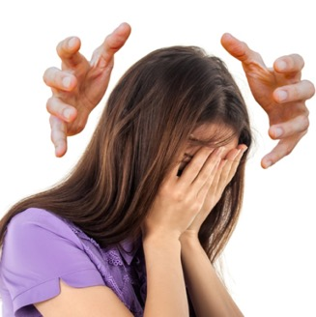
Managing your stressors

Slide 20
Action
There are four main strategies for reducing and removing the risks of stress. These are to:
Avoid the stressor
Change the stressor
Adapt to the stressor
Accept the stressor

Slide 21
Avoid the stressor
"What can I do to avoid or remove it from my life."
Learn how to say ‘no’
Control your environment
Avoid hot-topic buttons
Prioritise
Avoid distractions and interruptions
Avoid working excessive hours

Slide 22
Change the stressor
"What can I do to change the stressor."
Express feelings rather than bottling them up
Be willing to compromise
Be more assertive
Plan ahead

Slide 23
Adapt to the stressor
"What can I do to change my thinking, feelings or reactions to the stressor."
Reframe problems
Look at the big picture
Adjust your standards – perfectionism is over-rated
Focus on the positives

Slide 24
Accept the stressor
"What can I do to accept the stressors?"
Focus only on the things you can control
Look for the upside
Share your feelings
Learn to forgive
Be grateful for what you have
Show kindness to others

Slide 25
Managing stress – what else
Take a break and / or switch tasks
Do more of what you enjoy
Exercise
Friends / supporters
Try and keep your sense of humour!

Slide 26
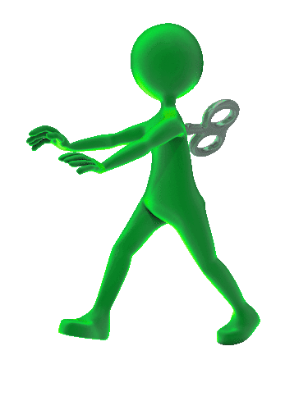

Self-Awareness
5%
RESULTS
Developing positive and precise rituals and habits

Slide 27
Where are you now?
Where do you want to be?
What will you do? How will you get there?
RESULTS

Slide 28
Working on yourself!
What could you do?
Be very specific on a change you want to make
Set out clearly what you will do
Keep a diary to note when things go well or not
Book in regular reflection time and use triggers to maintain this and other actions
Give yourself a score and update it
Enlist a supporter or network
Practice, practice, practice
Repeat

Slide 29

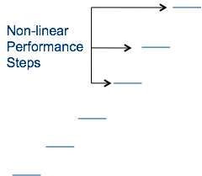

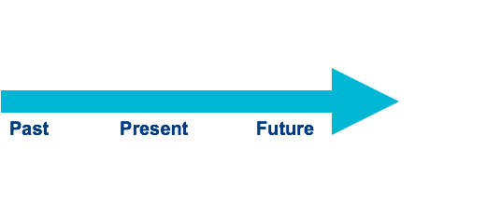

Energy – Spirit (Power)

Slide 30
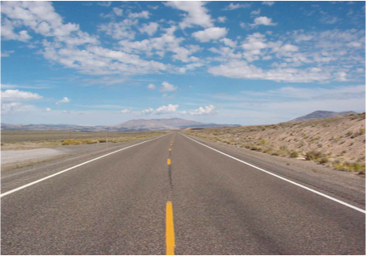
What’s your story?
What will your story be?
Your ideal life
Where I live, what do I do, the hours I work, the people I am with, the holidays I have, the interests I pursue….
How did I get here?

Slide 31
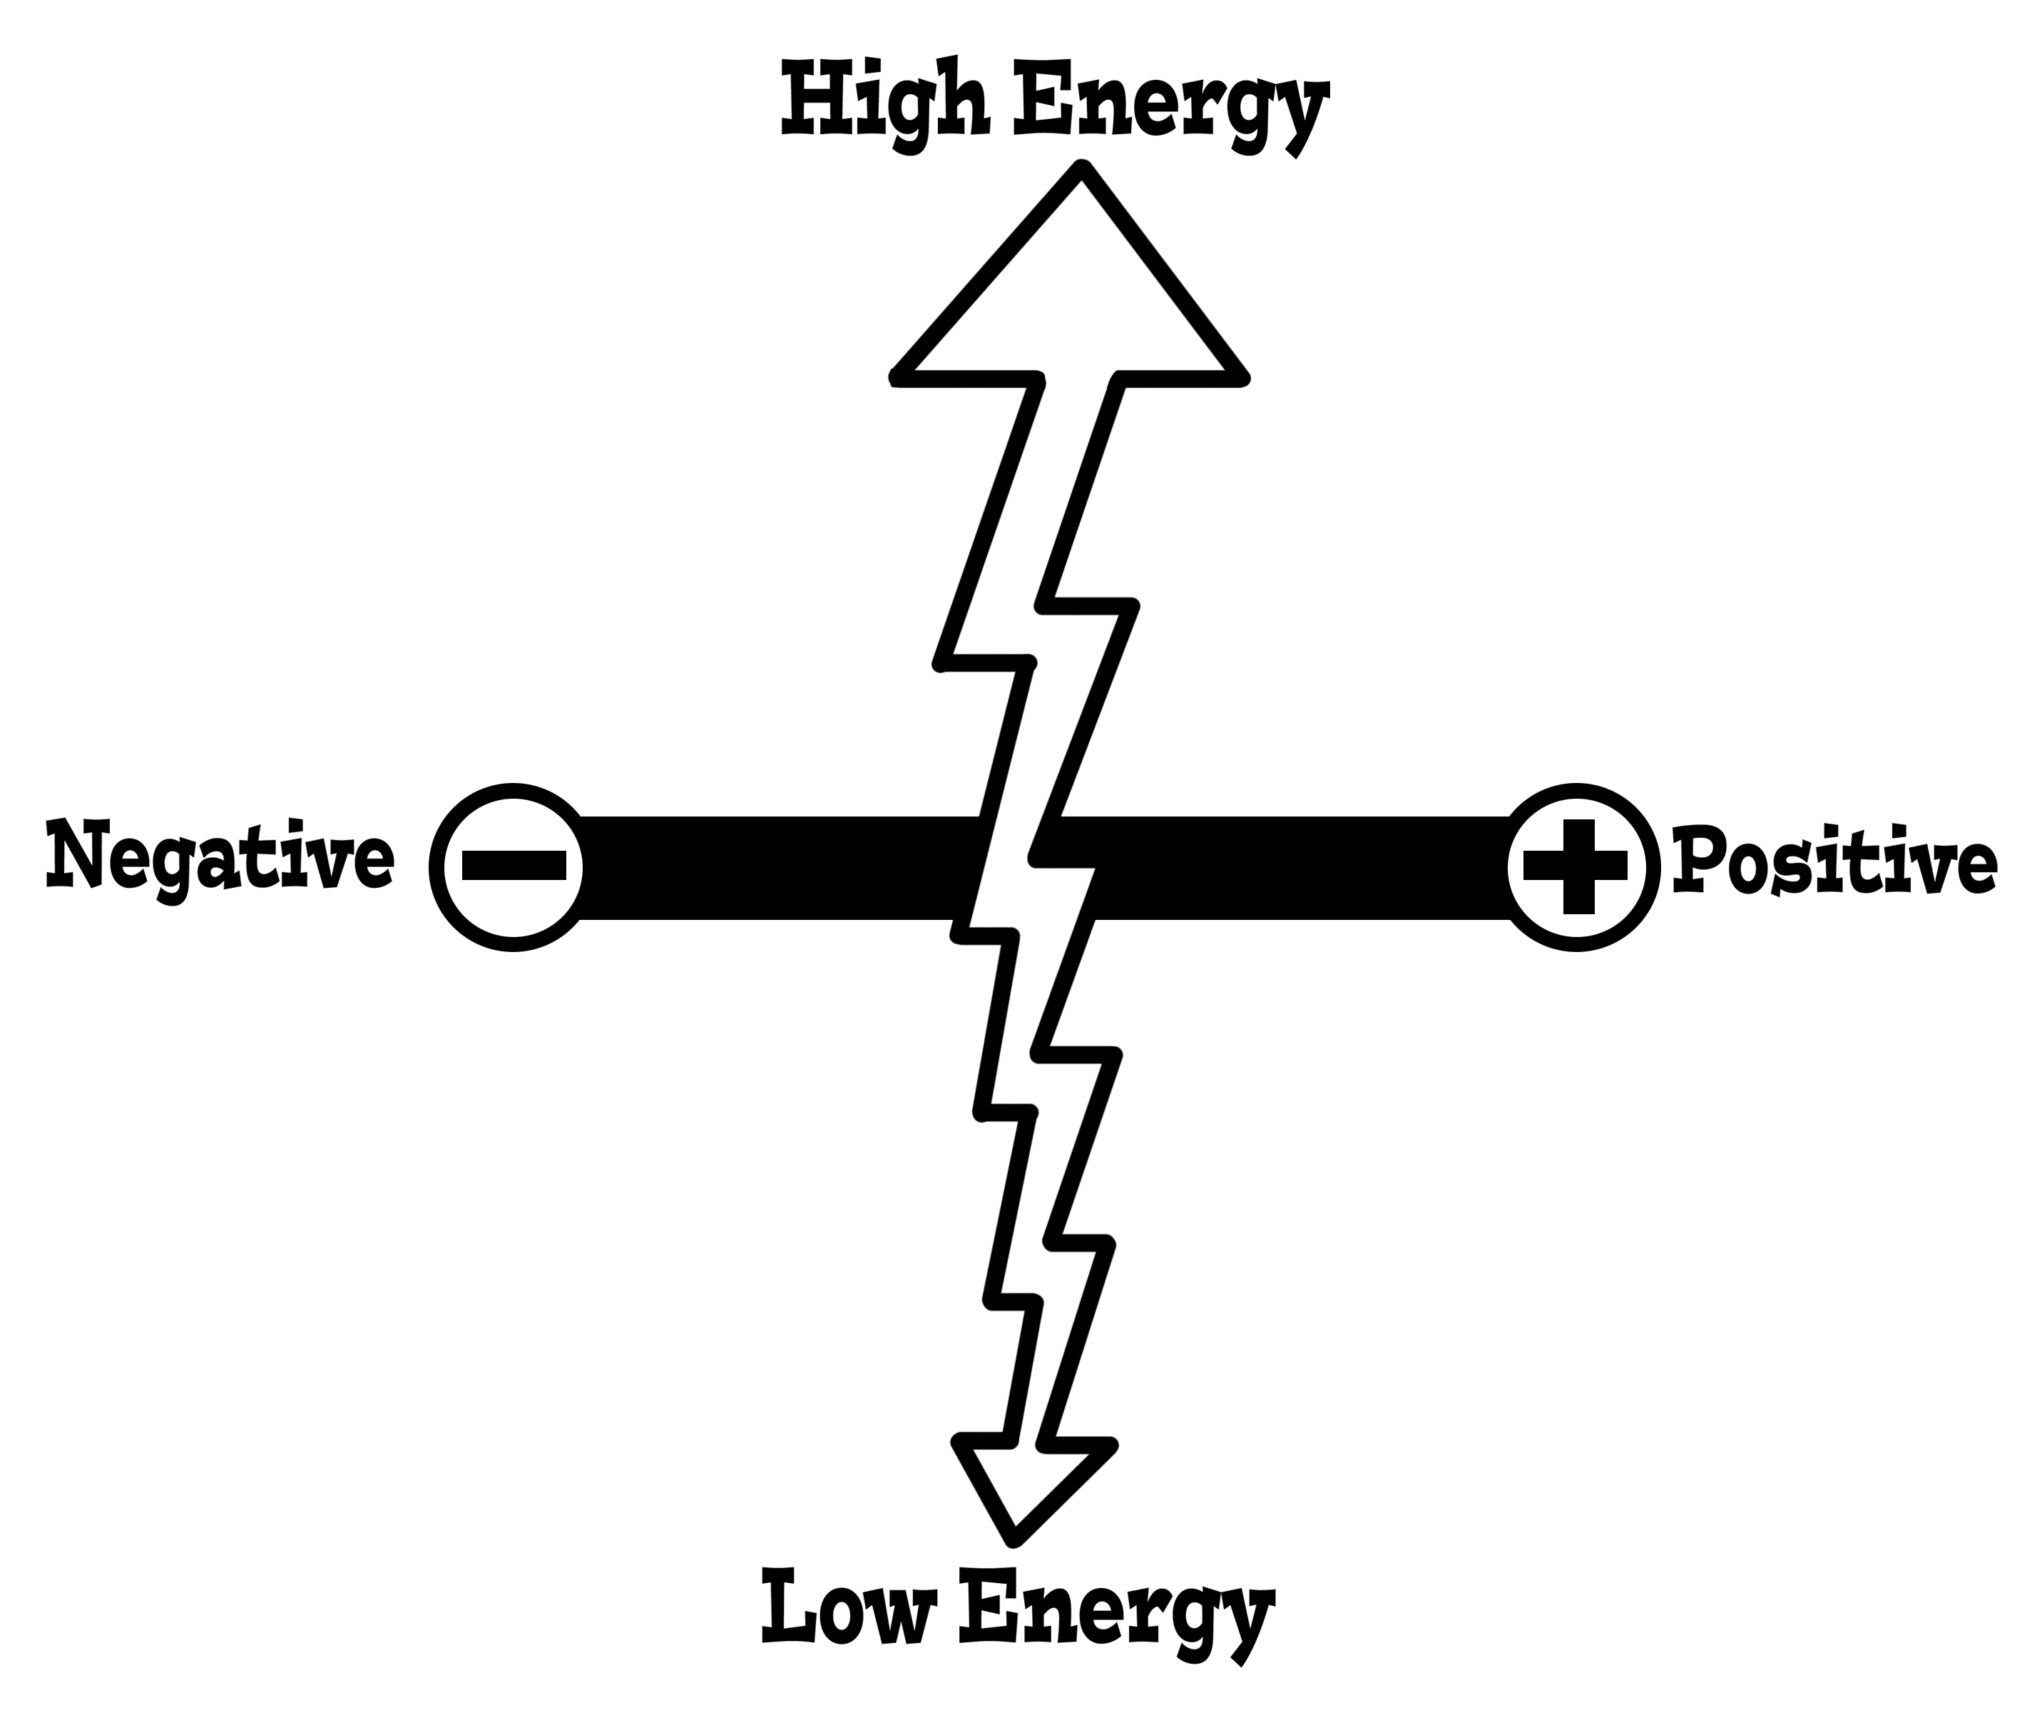
Energy – Emotion (Quality)

Slide 32
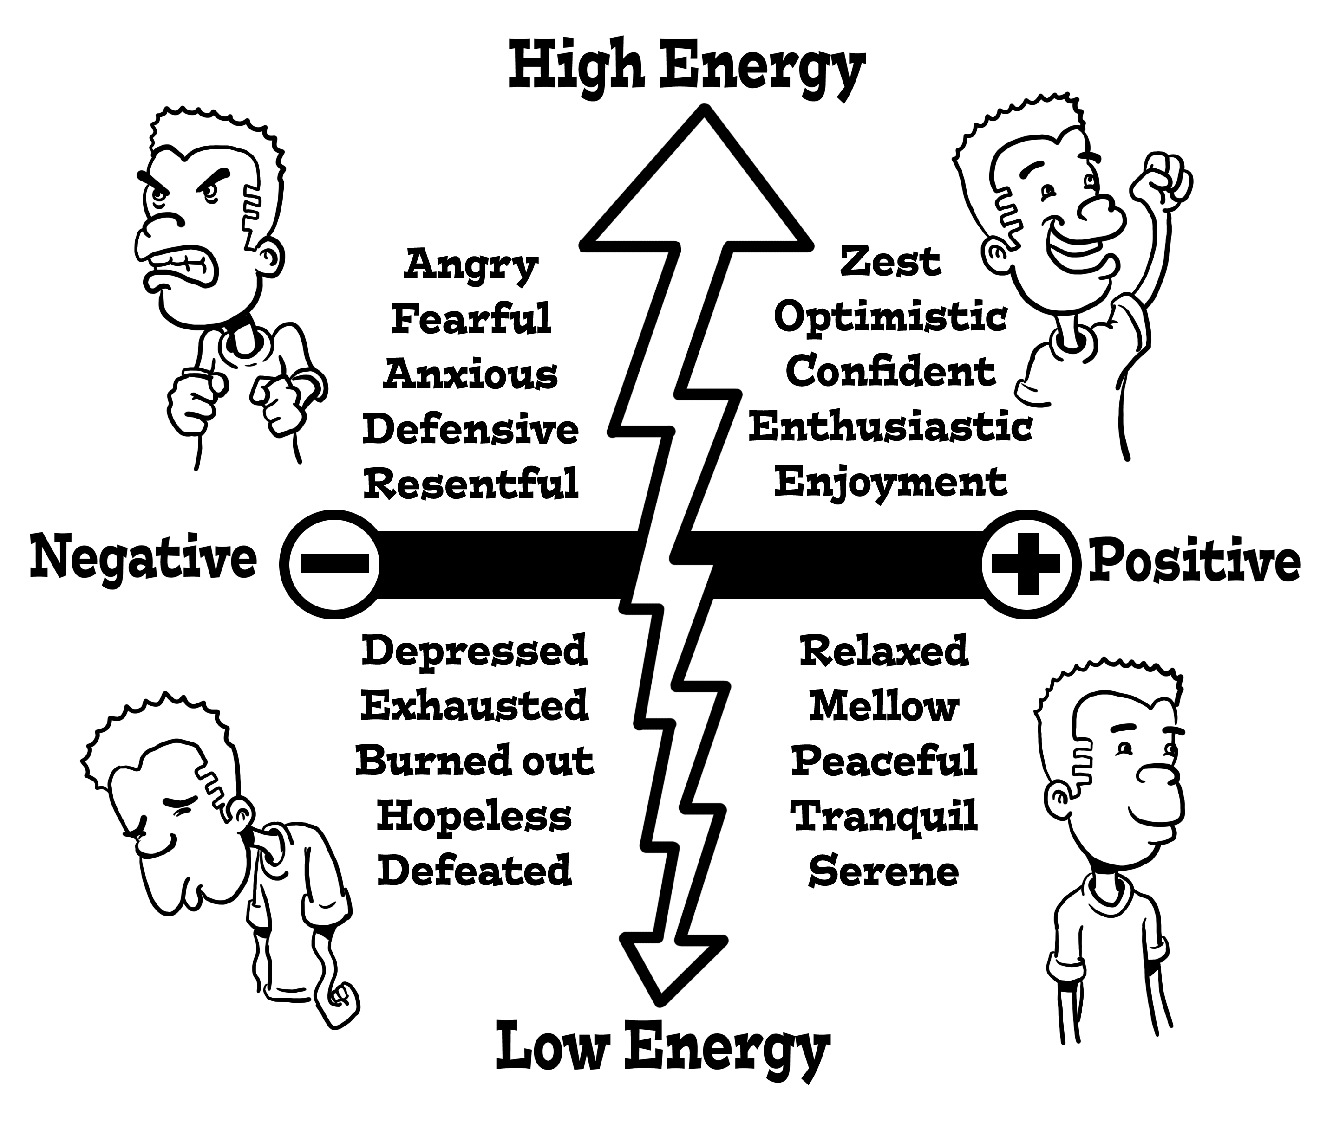
Energy – Emotion (Quality)

Slide 33
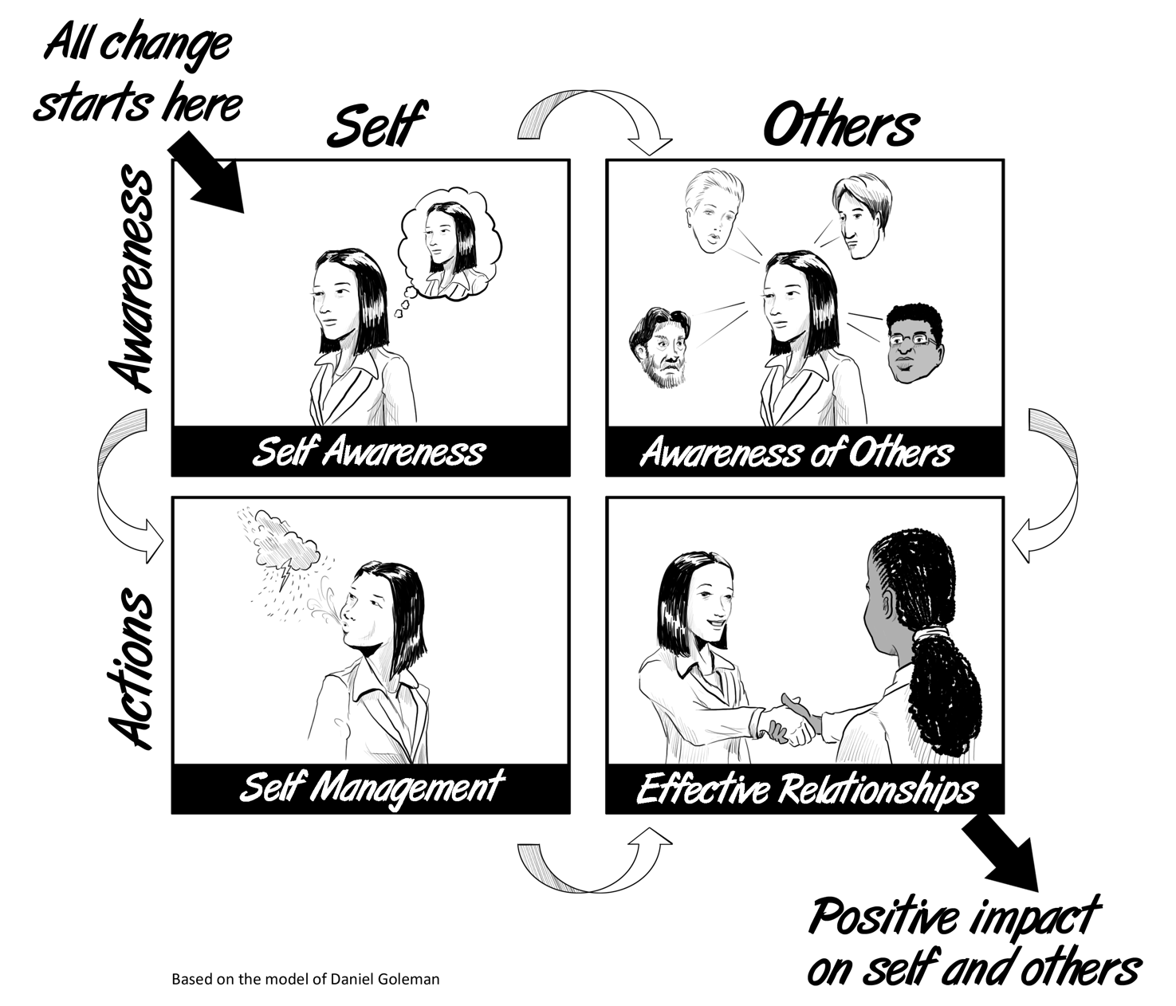
Energy – Emotion (Quality)
Relationships

Slide 34
Energy – Mind (Focus)

Slide 35





What is mindset?
Your Beliefs
How you see yourself?
How you see others?
How you see the world?

Slide 36
Dr. Steve Peters
Three beliefs about the world
…?
…?
…?

Slide 37
What is mindset?
Your Beliefs
How you see yourself?
How you see others?
How you see the world?
Life isn’t fair!
The goal posts always move!
There are no guarantees in life!

Slide 38
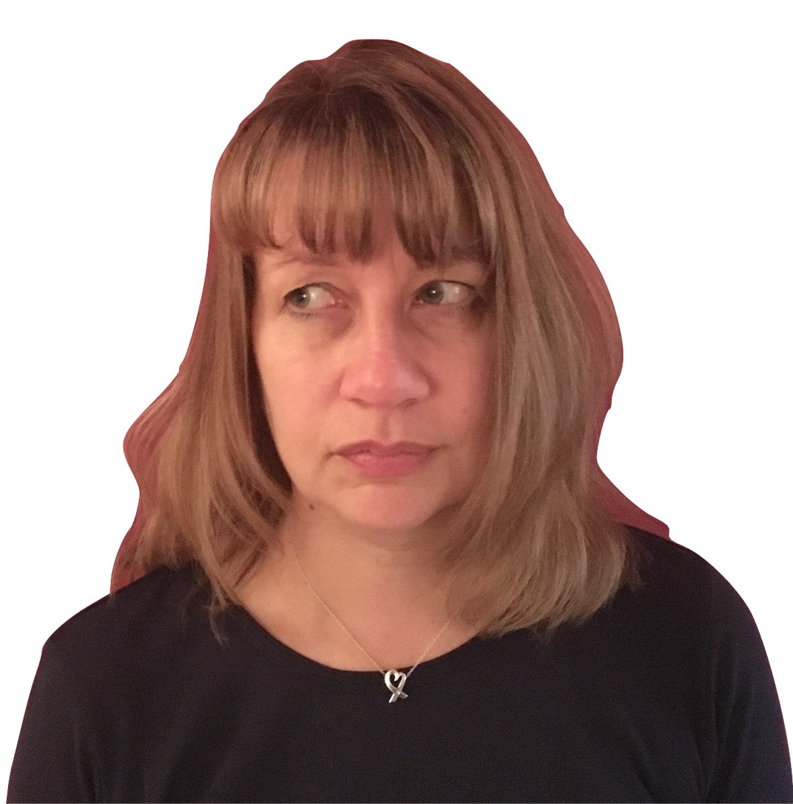
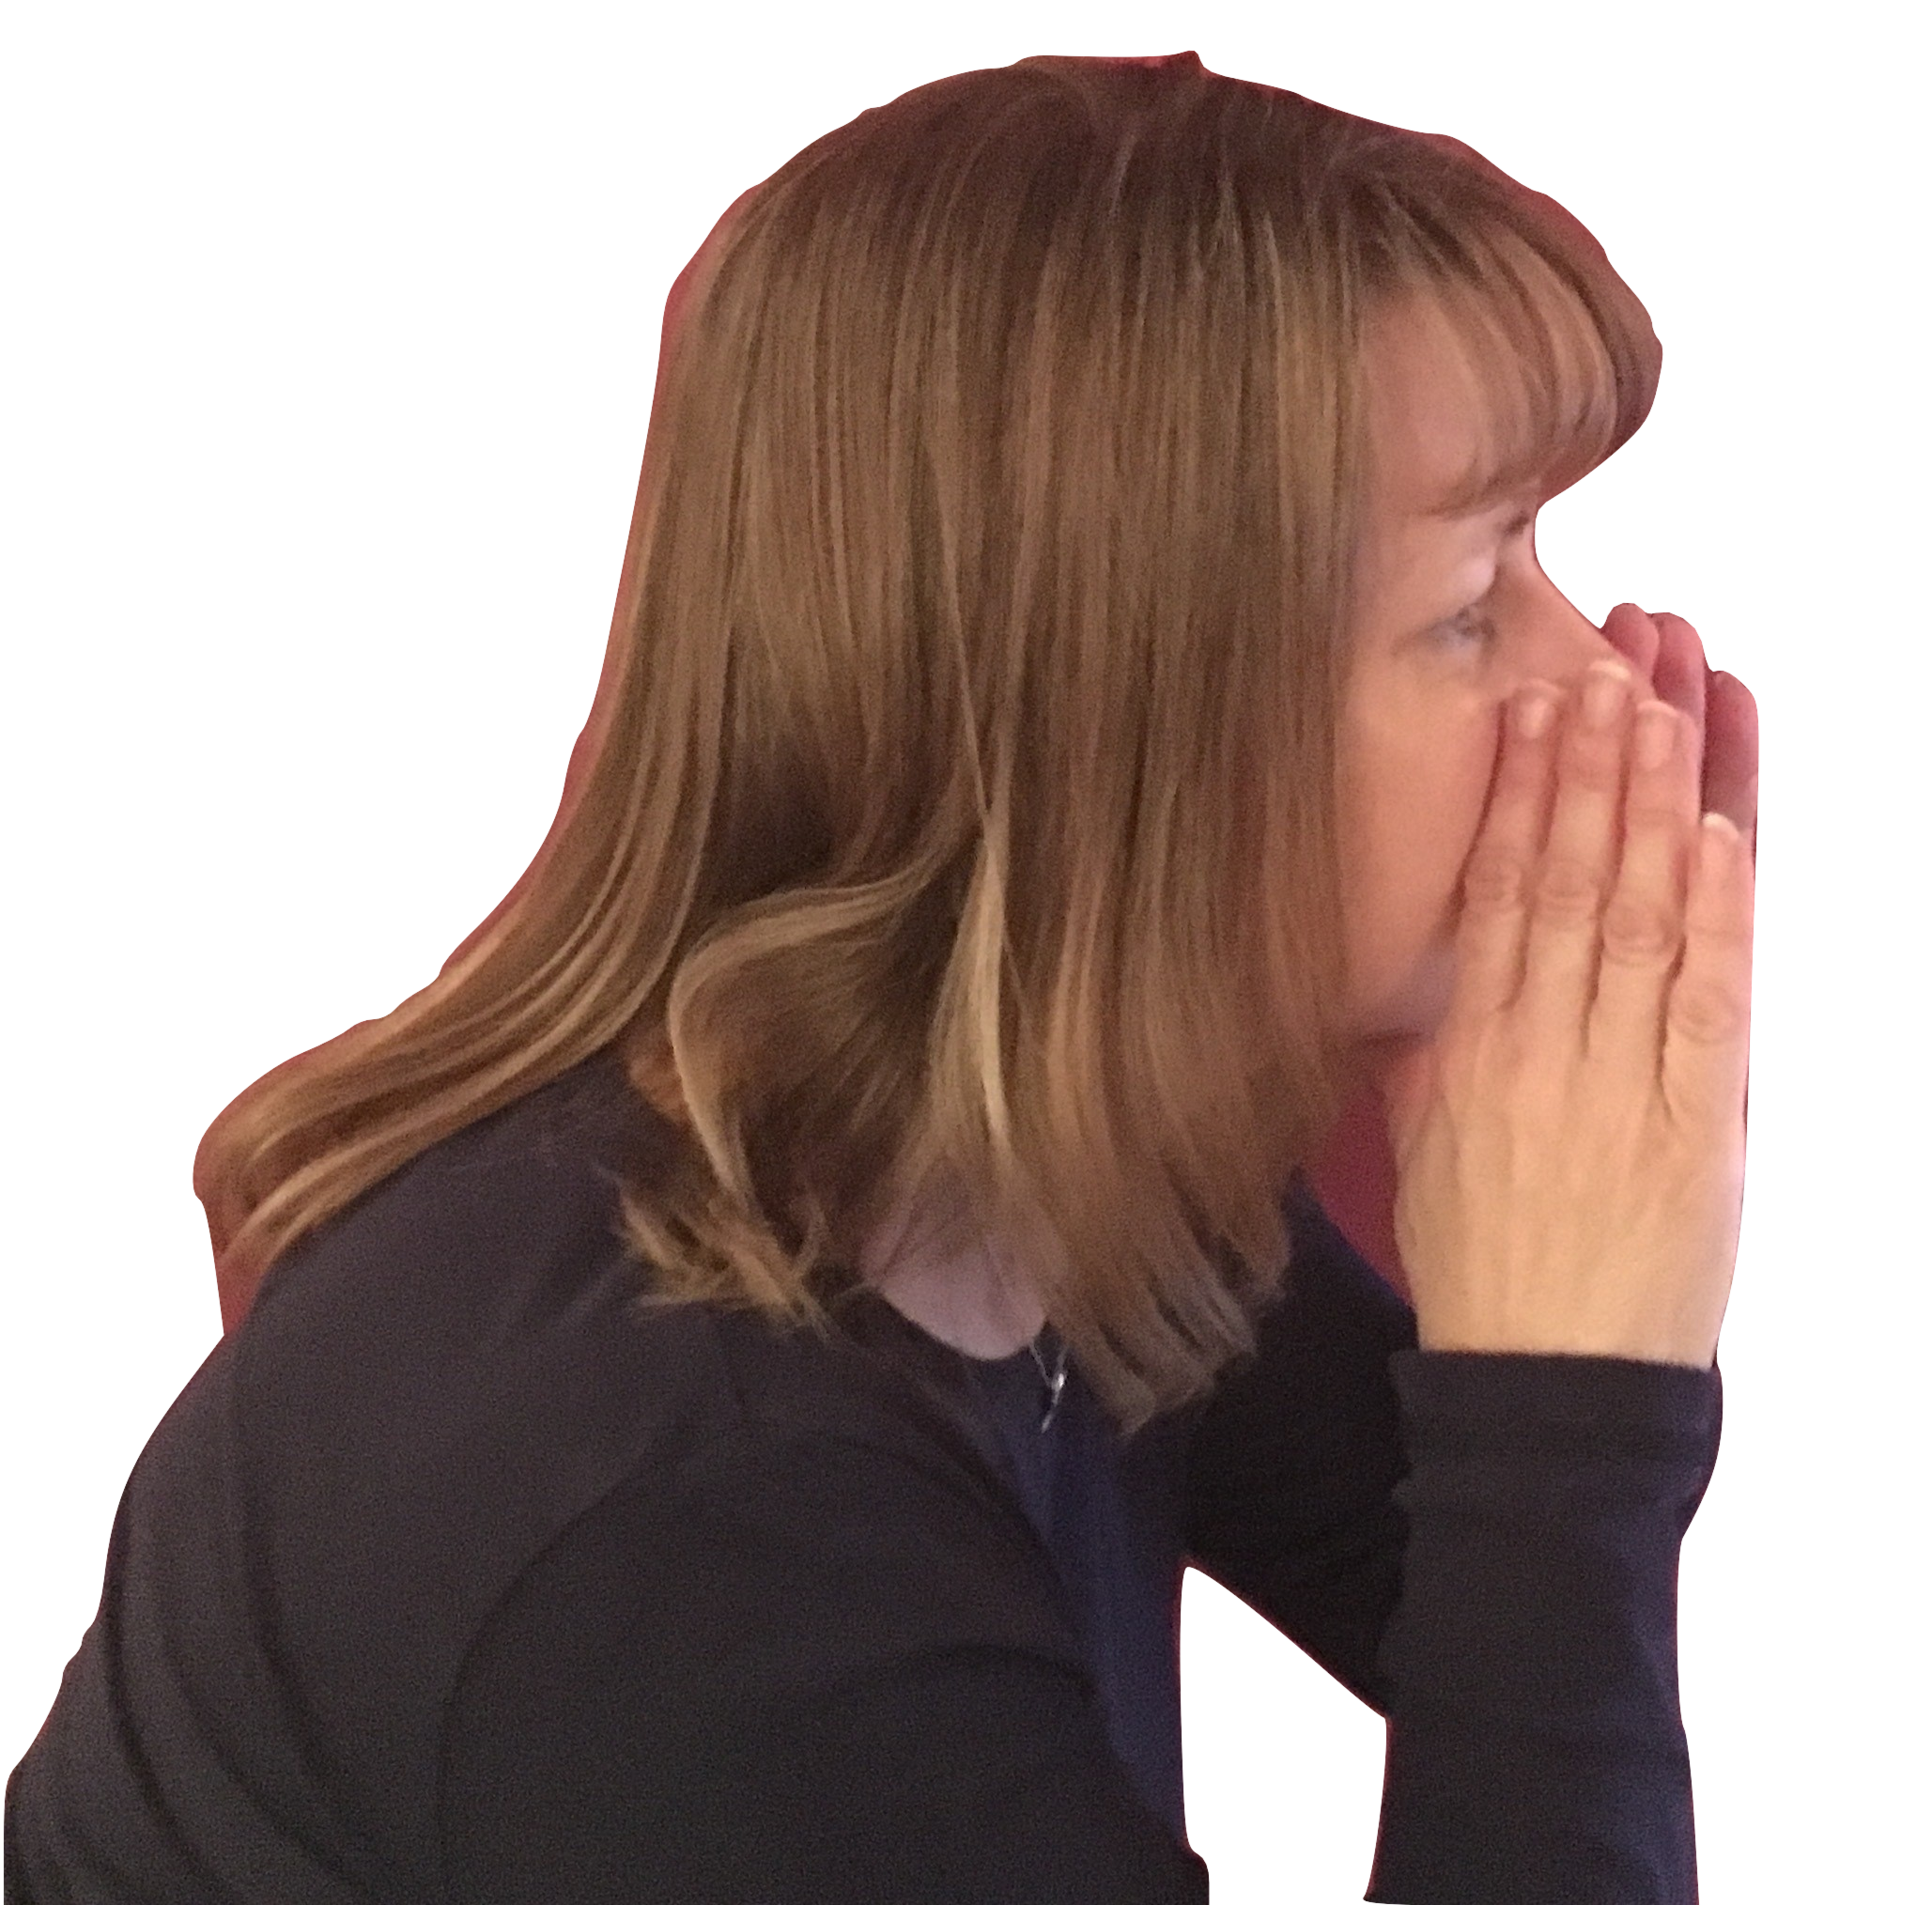
Your Inner Voice
What do you tell yourself?

Slide 39
Your Inner Voice
Dr. Barbara Fredrickson suggests that to be emotionally healthy we need a positive SELF TALK ratio of
3:1

Slide 40
Workload
You will never get everything done so quit trying!

Slide 41

The myth of multitasking
Ask yourself – how effective is this?
How easily are you taken off track and what are the causes of this?

Slide 42
The age of distraction
Emails
Interruptions
Multiple demands and from different people
Social Media…
News…
And much more….

Slide 43
Batch tasks and work in chunks
Most important jobs first (and not emails)
E-mails together not one at a time
You control your work and not the other way round
Set your working hours and make the work fit – whatever isn’t done is carried to the next day
Block time and avoid interruptions

Slide 44
What are your most important tasks?
The Pareto principle
The vital few (and trivial many) – Dr Joseph Juran

Slide 45
The Pareto Principle at work
We get the biggest results from a relatively small percentage of what we do! 20% input = 80% results.
OR 80% of what you do may not be effective!
An example
20% of an 8 hour day is 96 minutes
What do you really need to do and can be done in 96 minutes
Helps you get rid of the low level work which wastes your time
Or do more by doing less!

Slide 46

Your Vital few
Your current daily habits are…?
What should they be?

Slide 47
The right habits - Prioritisation
 | URGENT | NOT URGENT
IMPORTANT | DO FIRST (& REDUCE) Crises Pressing issues Deadline driven High Impact | SCHEDULE / PLAN Prevention / Strategic Long-term benefit Relationship building Recreation
NOT IMPORTANT | DELEGATE / TIME OUT Some email Some meetings Some calls & reports Some social activity | ELIMINATE Trivial matters Some email & calls Time wasters Busy work

Slide 48
The right habits - Prioritisation
Low effort, high impact – do immediately.
High effort, high impact – evaluate & plan (is it worth it).
Low effort, low impact – not a priority.
High effort, low impact – ditch it.

Slide 49
The right habits
What about my to don’t list?

Slide 50


Plan, Plan and Plan
Book out time (and stick to it)
Plan where to work and what you need
Do your most important tasks first each day
Avoid interruptions
Clear desk / organisation can help
Stick to the plan (in an emergency re-plan)

Slide 51
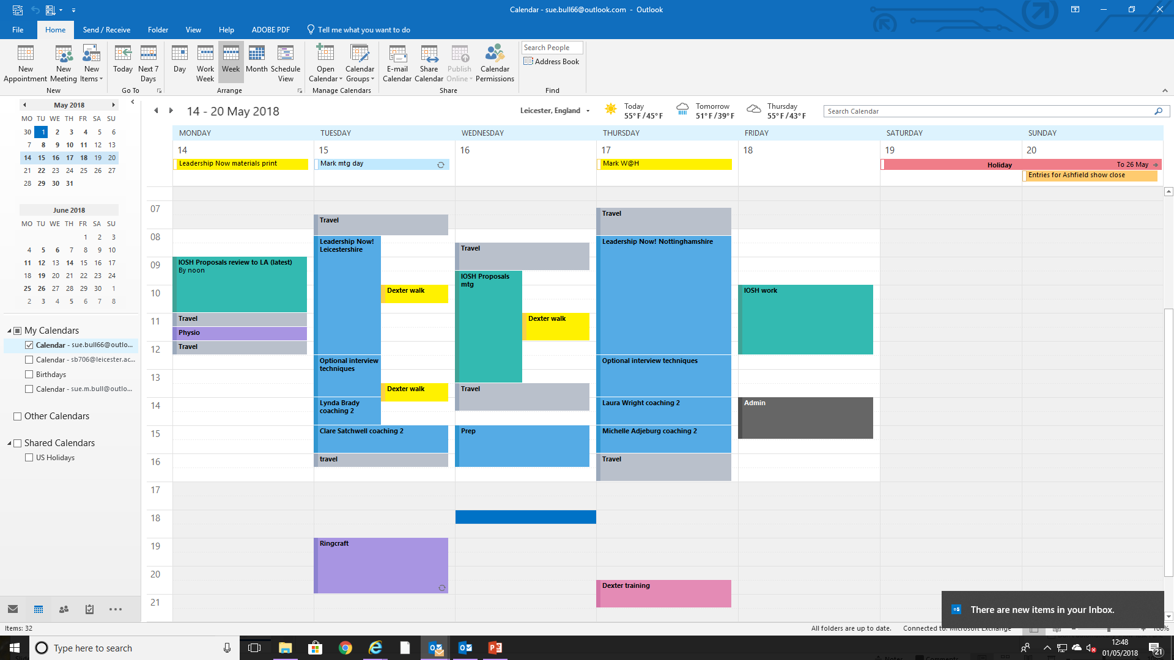
Use a diary (or equivalent)

Slide 52
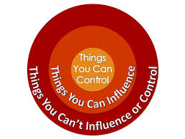
Control the controllables
What do you focus on that is outside of your control?
What can you do to focus only on those things within your control?

Slide 53
Dealing with interruptions
Is it always the same person/people?
Is the interruption valid? If not deal with it!
Catch your breath & train others
Learn to say “no”.
Available and non-available time.
Open door time vs visibility.

Slide 54
Manage meetings
Your own and others – what are the characteristics?
Why should you hold and attend effective meetings?
What should the rules be and what can you do as a holder and as an attendee to help this happen?

Slide 55
Use a process and technology to help with emails
E-mail and folder rules
Email protocols
Delete it
Deal with it if it takes 2 minutes or less
Put it into a reading file if it is something to read but no action (and then batch read at a set time each week)
Or add it to your plan or to to do list if action needed.
Turn off your phone (or remove work emails)
Automate where you can

Slide 56



Remember to also
Delegate when you can.
Set your working hours
Offer yourself a reward.
Choose organising tools that you like.
What works for one person may not work for you / all.

Slide 57
Energy – Body (Quantity)
Nutrition – what you eat and when
Hydration – regular drinking
Movement
Sleep
Exercise, relaxation, recovery
Alcohol / stimulants
Daily habits

Slide 58

LIFE BALANCE

Slide 59
It is about you
Your behaviours each day
What you allow and accept
Discipline

Slide 60
Energy Audit
Score 1 | Score 2 | Score 3 | Score 4
Quantity of Energy You Have - Body
Reserves between empty and 1/4 full | Reserves between 1/4 and 1/2 full | Reserves between 1/2 and 3/4 full | Reserves between 3/4 full and full
Quality of Your Energy - Emotion
Fully negative | More negative than positive | More positive than negative | Fully positive
Focus of Your Energy - Mind
Fully scattered | More scattered than focused | More focused than scattered | Fully focused
Power of Your Energy - Spirit
Fully uncommitted | More uncommitted than committed | More committed than uncommitted | Fully committed

Slide 61

My Learning

Slide 62
ONE THING

Slide 63
GET IN TOUCH
support@welbee.co.uk

